Slide 1
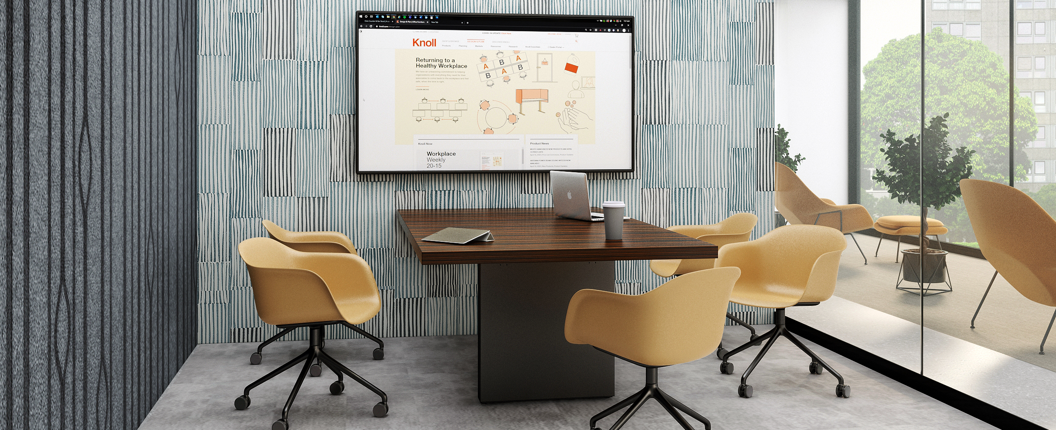
DatesWeiser
Product Updates: February 15, 2021

Slide 2
JD Media Table Launch
The JD Media table was designed to support hybrid work and facilitate in-person and remote collaboration.
Available February release of CAP.
DETAILS
JD Media Table offers a breadth of planning options, comprised of three components—a table-top, base and the ability to add a full or partial height media wall for wire management.
Plan either in the open plan with the freestanding version or in enclosed rooms with installation against an architectural wall.
The table-tops are available in two shapes:
  Rectangle - Widths: 60, 72, 84, 96“; Depths: 42”, 48”, 54”
  Trapezoid - Widths: 60, 72, 84, 96“; Depths: 42/54”
Available at two heights – 29.25” and 41.5”
See JD Collection Price List for details
3-week lead time in Q1 and Q2 2021

